Slide 1
Verification and Testing
Solution Package

Slide 2
Testing and Validation
A Test Plan is a grouping of Test Runs
A Test Run can be:
Are assigned to „Tester“ and „Test Reviewer“
Related to a Simulation and its results
Defined Test Procedures with recorded results
Run automated
Run step by step manually with automated results recording
Run step by step manually with manual results recording
Test Plan Templates
Optional Integration with Aras RE, SM, SA
Provide evidence that Requirements are satisfied by related Product Design
Evidences are the result of Test Runs.

Slide 3
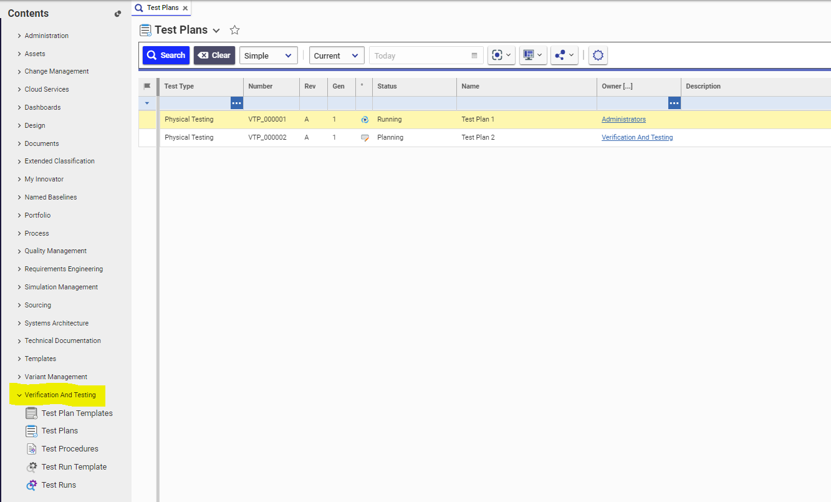
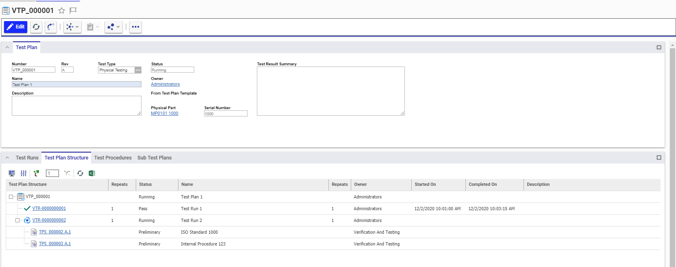
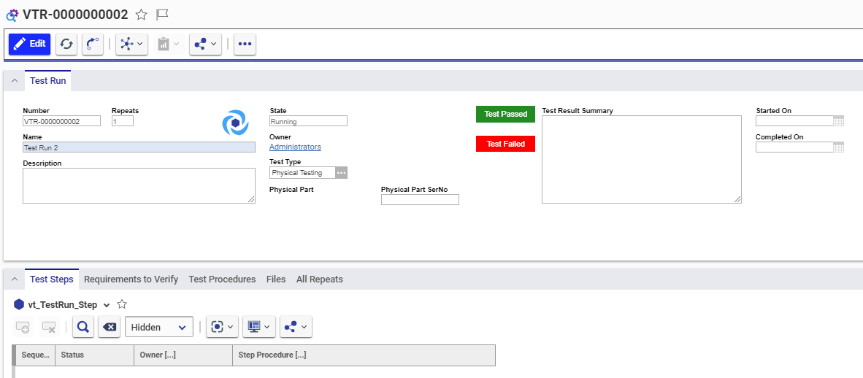

Slide 4
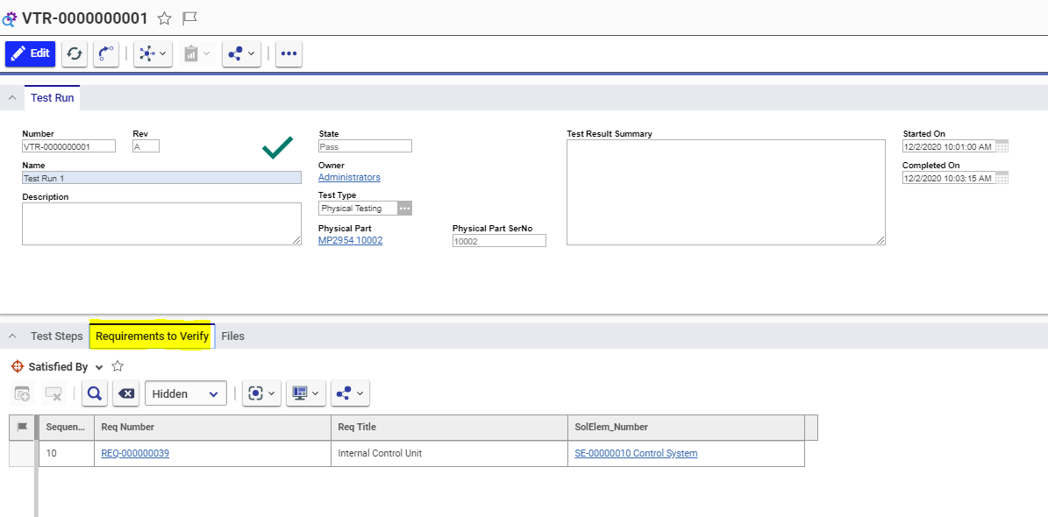
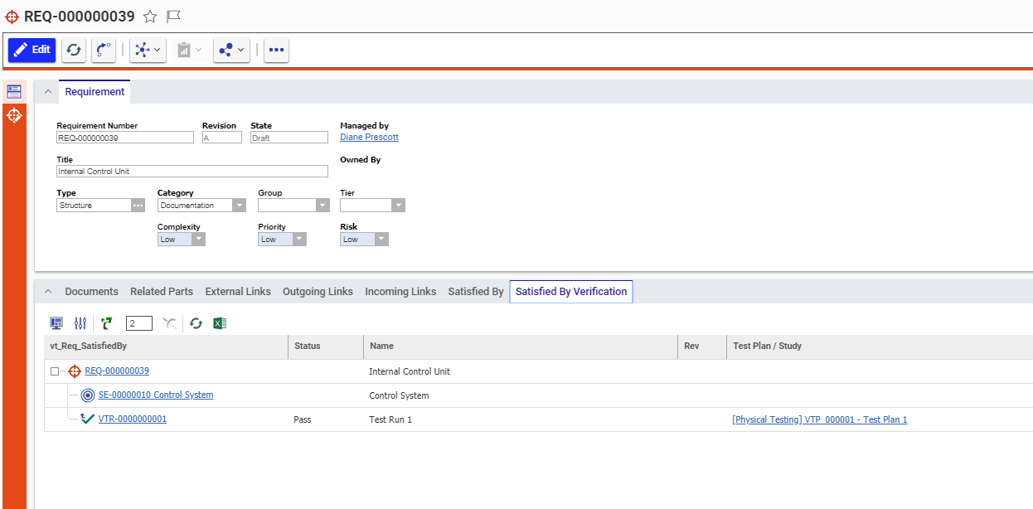
Connected with Requirements

Slide 5
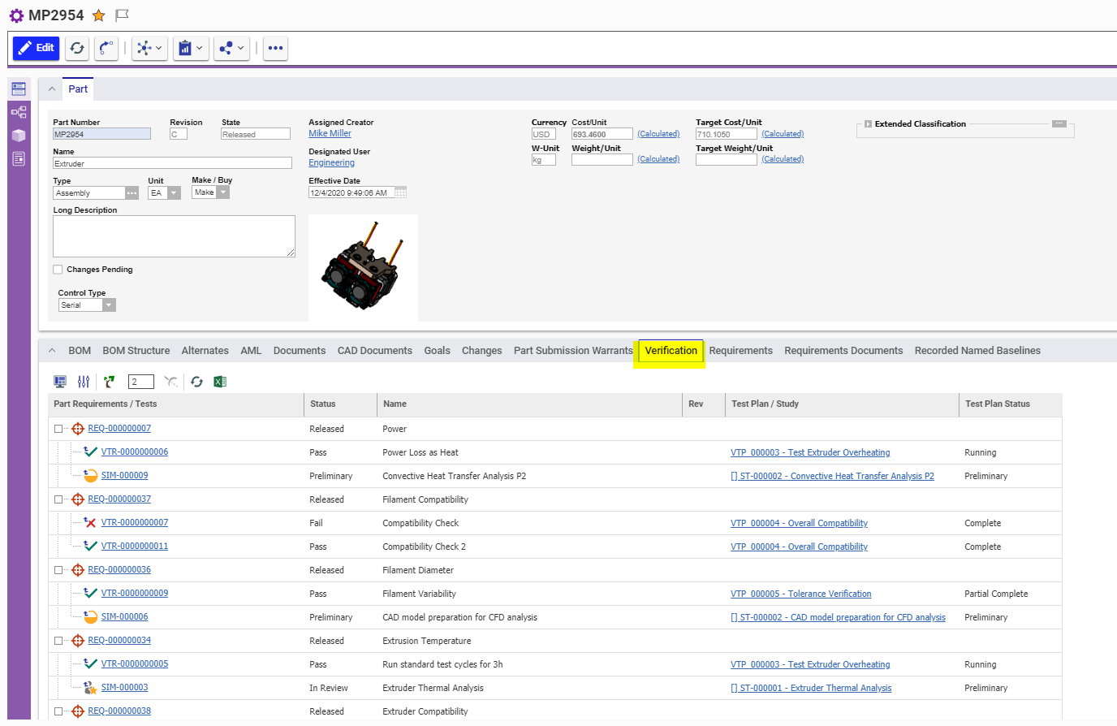
Design Validation of Requirements – via Simulation or Tests on Engineering Parts

Slide 6
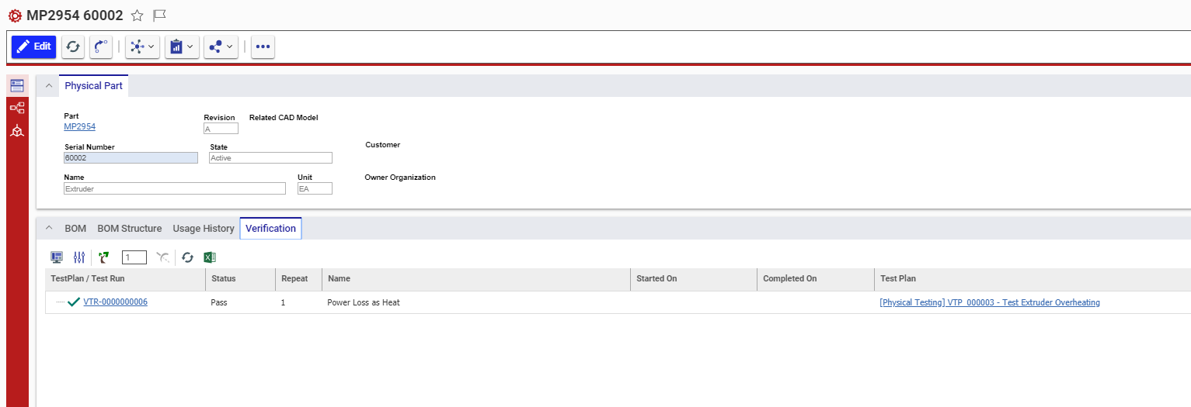
Testing (Verification) History – On Physical Parts

Slide 7
Data Object Model
Prefix: vt_ (Validation and Testing)
<<ItemType>>
PhyicalPart
<<PolyItemType>>
sm_DesignRepresentation
from other Aras Apps
<<ItemType>>
sm_Task
Test Plan Types:
-Design Validation
-Physical Testing
LifeCycle
<<ItemType>>
vt_TestPlan
<<RelationshipType>>
vt_sm_Task_ReqToValidate
<<ItemType>>
Part
<<ItemType>>
sys_Function
<<ItemType>>
sys_SystemElement
<<RelationshipType>>
vt_TestPlan_Run
<<RelationshipType>>
re_Part_Requirement
<<RelationshipType>>
vt_TestPlan_DependsOnRun
<<ItemType>>
Requirement
LifeCycle
<<RelationshipType>>
sys_Reqt SolutionElement
“Satisfied By”
<<PolyItemType>>
sys_SolutionElement
Test Run Types:
-Design Validation
-Physical Testing
<<ItemType>>
vt_TestRun
<<RelationshipType>>
vt_TestRun_ReqToValidate
<<RelationshipType>>
vt_ Reqt vt_ Reqt SolElement_TesRun_tgv
Procedure Types:
-General
-Internal Standard
-ISO Standard
TreeGridView
“Test Runs”
LifeCycle
<<RelationshipType>>
vt_TestRun_Step
LifeCycle
<<ItemType>>
vt_TestProcedure
<<RelationshipType>>
vt_TestRun_Result File
<<RelationshipType>>
vt_TestRun_SatisfiedProcedure
<<File>>
hard_fixed

Slide 8
Data Object Model – Adding Templating
Prefix: vt_ (Validation and Testing)
Method code to instatiate TestPlan from Template
LifeCycle
Test Plan Templ Types:
-Design Validation
-Physical Testing
LifeCycle
<<ItemType>>
vt_TestPlanTemplate
Test Plan Types:
-Design Validation
-Physical Testing
<<ItemType>>
vt_TestPlan
<<RelationshipType>>
vt_TestPlanTempl_Run
<<RelationshipType>>
vt_TestPlan_Run
LifeCycle
<<ItemType>>
vt_TestRunTemplate
<<RelationshipType>>
vt_TestPlan_DependsOnRun
<<RelationshipType>>
vt_TestPlanTempl_RunProcedure
float
LifeCycle
Test Run Types:
-Design Validation
-Physical Testing
<<ItemType>>
vt_TestRun
Procedure Types:
-General
-Internal Standard
-ISO Standard
<<RelationshipType>>
vt_TestRun_ReqToValidate
LifeCycle
<<RelationshipType>>
vt_TestRun_Step
LifeCycle
<<ItemType>>
vt_TestProcedure
<<RelationshipType>>
vt_TestRun_Result File
<<RelationshipType>>
vt_TestRun_SatisfiedProcedure
<<File>>
hard_fixed

